Slide 1
A Brief View of Nanotechnology in Medicine
By Jaskaran S. Dhillon
March 2010

Slide 2
What is Nanotechnology?
A disruptive technology, with a potential to change the world as we know it today.
What is Nanotechnology? It is the study of controlling and manipulating matter on an atomic and/or molecular scale.
It deals with structures the size of 100 nanometers or smaller in at least one dimension.
It’s a very diverse technology

Slide 3
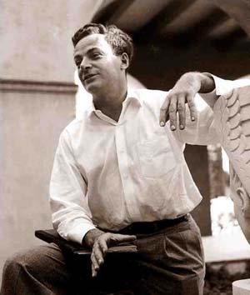
A Brief History of Nanotechnology
On December 29, 1959, physicist Richard Feynman gave a radical lecture at an American Physical Society meeting at Caltech titled “There’s Plenty of Room at the Bottom”.
Feynman suggested that it should be possible, in principle, to make machines at a nano-scale that "arrange the atoms the way we want", and do chemical synthesis by mechanical manipulation.
With this lecture was the birth of the idea and study of nanotechnology.

Slide 4
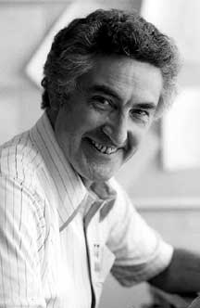
Hibbs’s Idea on Nanotechnology in Medicine
Albert R. Hibbs was a noted mathematician. Hibbs was fascinated by self-actuated machines—a field where he collaborated in a well known idea-experiment of Feynman's. According to Feynman, it was Hibbs who originally suggested to him (circa 1959) the idea of a medical use for Feynman's theoretical micromachines.
“A friend of mine (Albert R. Hibbs) suggests a very interesting possibility for relatively small machines. He says that, although it is a very wild idea, it would be interesting in surgery if you could swallow the surgeon. You put the mechanical surgeon inside the blood vessel and it goes into the heart and ``looks'' around … It finds out which valve is the faulty one and takes a little knife and slices it out. Other small machines might be permanently incorporated in the body to assist some inadequately-functioning organ”. – Richard Feynman, “There’s Plenty of Room at the Bottom”.
What Feynman and Hibbs considered a possibility, today 51 years later, is becoming a reality.

Slide 5
Applications of Medical Nanotechnology
Applications of medical nanotechnology span across a variety of areas such as
In Drugs, Medicines, Therapeutics, etc
In Diagnostics of diseases, abnormal conditions etc.
In Surgery
In Medical Robotics
In the general sake of increasing knowledge of the human body

Slide 6
Applications in Drugs and Medicine
Nanotechnology can deliver medicine or drugs into specific parts of the human body, thereby making them more effective and less harmful to the other parts of the body.
A recent study conducted by NIH found anti-cancer gold nanoparticles very effective. Gold has been known to be one of the most unreactive metals on the periodic table and it can also be heated to high temperatures before melting. Due to this, “nanoshells” made of gold are useful to fight cancer (particularly soft-tissue tumors), also because of their ability to absorb radiation at certain wavelengths. Once the nanoshells enter tumor cells and radiation treatment is applied, they absorb the energy and heat up enough to kill the cancer cells. Not only gold but other elements can also be used.

Slide 7
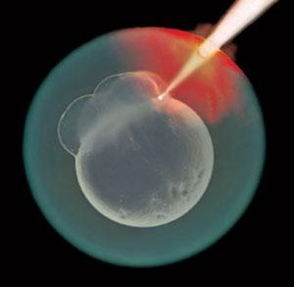
Applications in Surgery
In many cases, surgery must be done on a minute part of the body but to ensure that all danger (such as a tumor) is removed, extensive surgery (and thus skin damage) must be done. With nanotechnology, however, minute surgical instruments and robots can be made which can be used to perform microsurgeries on any part of the body. Instead of damaging a large amount of the body, these instruments would be able precise and accurate, targeting only the area where surgery should be done.
Visualization of surgery can also be improved using nanotechnology. Instead of a surgeon holding the instrument, computers can be used to control the nano-sized surgical instruments. “Nanocameras” can provide close up visualization of the surgery. Thus, there is also a very less chance of any mistakes or faults being made
Surgery could also be done on tissue, genetic and cellular levels.

Slide 8
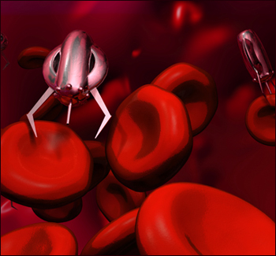
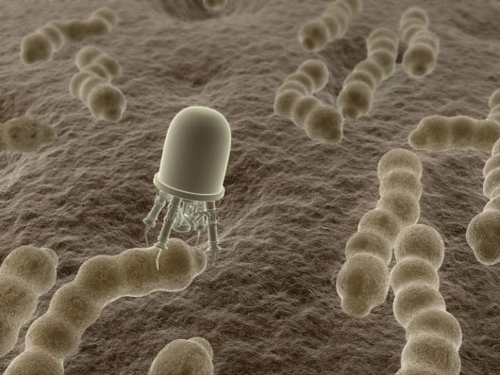
Applications in Medicinal Robotics
Nanotechnology, perhaps, has been most popularly recognized for it’s applications in robotics. Nano-robotics, although having many applications in other areas, have the most useful and variety of uses in medical fields.
Potential applications of nanorobotics in medicine include early diagnosis and targeted drug delivery for cancer, biomedical instrumentation, surgery, pharmacokinetics, monitoring of diabetes, and health care. In such plans, future medical nanotechnology is expected to employ nanorobots injected into the patient to perform treatment on a cellular level.

Slide 9
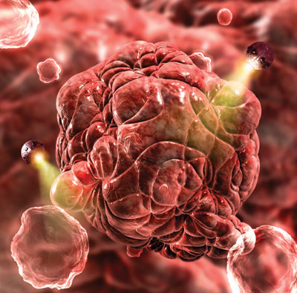
Miscellaneous Applications of Nanotechnology in Health
With nanorobotics, we can take snapshots of the human body. We can better understand how exactly the human body works. Thus, our knowledge will be enhanced as well. The workings of cells, bacteria, viruses etc can be better explored. The causes of relatively new diseases can be found and prevented.
Nanorobotics may be able to help to restore vision. Genome sequencing can be made much easier. Biological causes of mental diseases can be monitored and identified. Simple curiosity can be answered.
“Tissue engineering” could also be done using nano-materials. Tissue engineering makes use of artificially stimulated cell proliferation by using suitable nanomaterial-based scaffolds and growth factors. Advances in nanotechnology-based tissue engineering could also lead to life extension in humans and other animals.

Slide 10
Social Issues of Nanotechnology in Medicine
How many nanotechnology implementations in the human body (to protect against diseases and to offer “enhanced immunization”) would it take for a human to no longer remain human?
Fear of decrease the gap between humans and robots/computers
Who will have control over nanomedicinal technology?
Will this possesion/control render a bias for treatment and use on basis of ethnicity, color and race, not to mention political standings and viewpoints?

Slide 11
Social Issues (Continued)
The issue of human feedback and dignity is also present. The ability to detect a single cancerous cell or slightly elevated biometrics could have profound effects upon how individuals think about the status of their health and bodies.
A heightened awareness of one’s health status could have profound effects on how an individual thinks about his/her health, and this may cause psychological harm/effects such as anxiety, paranoia, etc.

Slide 12
Economical Issues of Nanotechnology in Medicine
Will “nanomedicine” widen the gap between the rich and the poor in its initial stages like many disruptive technologies of the past?
Is there a certain patent for nanomedicine? How much will the ideas of nanomedicine sell for?
Does nanomedicine favor the rich or the poor? Will the poor get equal access to nanomedicine and other nano-medicinal technologies?

Slide 13
Ethical Issues of Nanotechnology in Medicine
Bioethical researchers believe that nanomedicine could be manipulated to harm the human body rather than healing it.
How would the use of a technology that can’t be seen be regulated? What if, they say, the guiding system on the medicine malfunctions and takes the medicine to the wrong part of the body, such as the brain?
Another scenario taken into consideration: bioterrorism. What if the nanomedicine technology is used for terrorism purposes? Particles that can’t be seen or easily controlled would enter the body and deliver harmful substances such as toxins.
Will the materials used for the nano-medicinal technologies be non-toxic and eco-friendly?

Slide 14
What Lessons Have We and Should We Learn?
There certainly are more questions than adequate answers.
Every technology made till date has been made in hopes of improving or benefiting human life. However, it is only misuse of technology that impacts humankind in a negative way.
Scientists are currently researching better electronics and safe materials for nanomedicine alongside nanomedicine itself. The technology is being regulated by the government with the primary concern being safety of the people.
We can certainly say that nanomedical technology, if used carefully and meticulously, will guarantee great benefits.

Slide 15
To Conclude…
As Richard E. Smalley, PhD, 1996 Nobel Laureate, once said,
“Human health has always been determined on the nanometer scale; this is where the structure and properties of the machines of life work in every one of the cells in every living thing. The practical impact of nanoscience on human health will be huge.”

Slide 16
Additional Links and Resources
http://www.nanotech-now.com/nanotechnology-medicine-glossary.htm - A great Medical Nanotechnology Dictionary providing the names and definitions of various existing and hypothetical devices.
http://www.ncbi.nlm.nih.gov/pmc/issues/178370 - A link to an official government nanotechnology journal published by NIH (National Institute of Health) – “International Journal of Nanomedicine”. The articles are all open-source and updated with the newest developments in biomedical nanotechnology.
http://en.wikipedia.org/wiki/Nanomedicine - A link to a Wikipedia article and portal on Nanomedicine.
http://www.wisc-online.com/objects/ViewObject.aspx?ID=NAN405 – A great animated and interactive slideshow on Nanotechnology and its application on the cellular level.
http://www.wellcome.ac.uk/democs/flash/runflash.html - A great interactive animation made to show just how small “nano” is.

Slide 17
Image Citations (In Order Of Appearance)
http://eands.caltech.edu/articles/LXVI/alhibbs.html
http://www.uofaweb.ualberta.ca/ece/images/FishyNews.jpg
http://nanomedicinetoday.files.wordpress.com/2009/03/two-a1.jpg

Slide 18
The End

